Slide 1
2023 AAPD Fall Internship Program
Information Session
May 18, 2023 4:00-4:30pm EST

Slide 2
Housekeeping Items
Recording available next week
Closed Captioning
ASL Interpreter
Questions & Answers

Slide 3
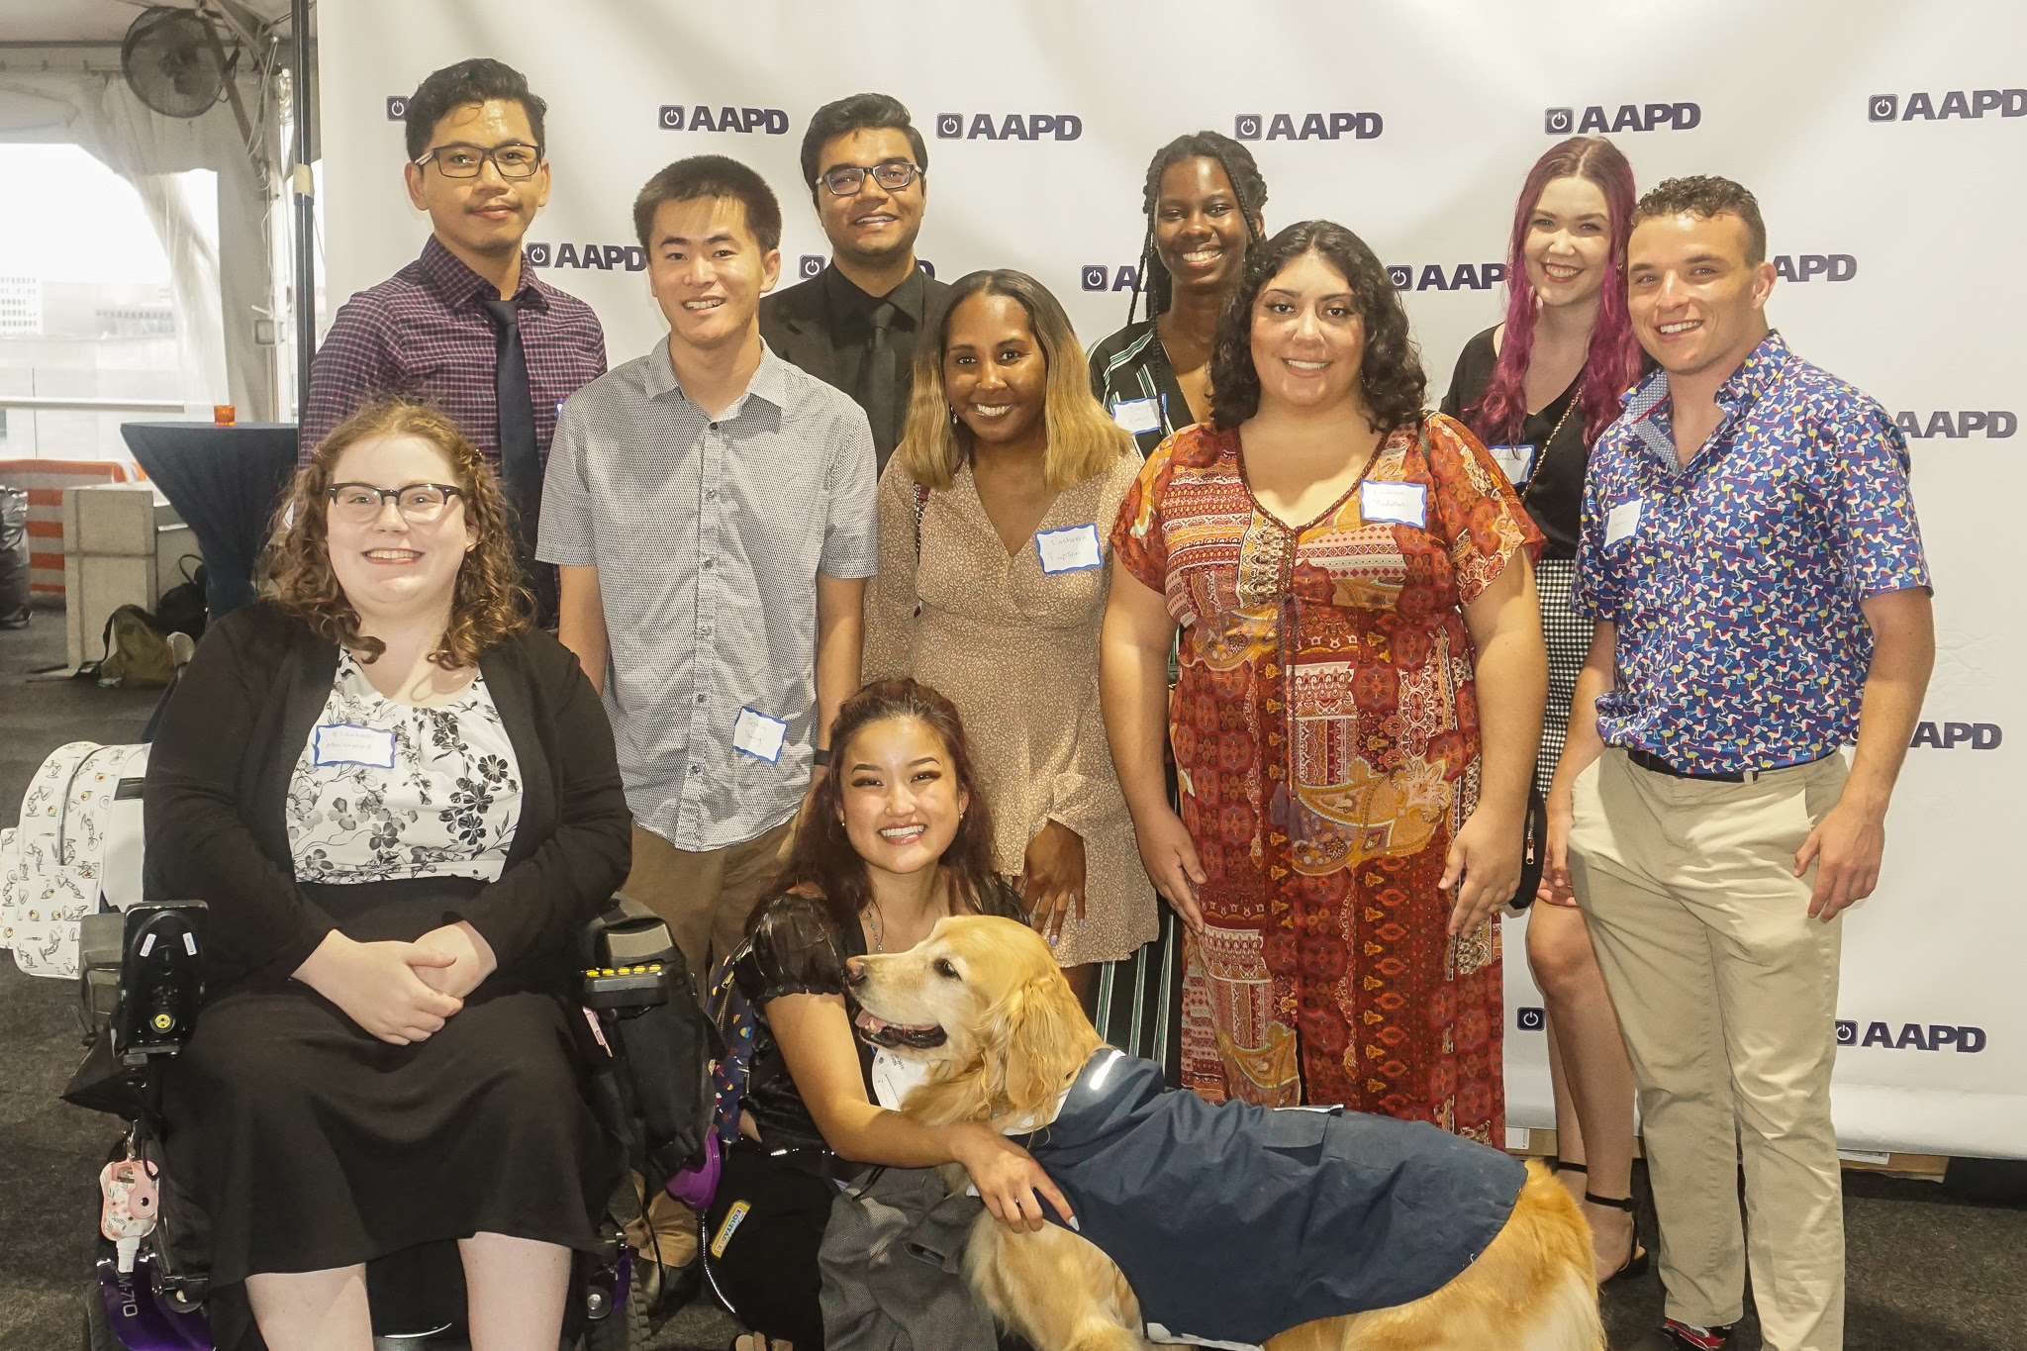
Agenda
Overview of Fall Internship Program
Application Process and Timeline
Q&A and Wrap Up

Slide 4
The 2023 Fall Internship Program
Fully Virtual
10 week paid part-time internship
October 2 to December 8
Work 15-20 hours a week
$18/hour stipend

Slide 5
Fall Placement Sites
Elevance Health
Hand in Hand: The Domestic Employer’s Network
Paul K. Longmore Institute
National Disability Rights Network
Senate Health, Education, Labor, and Pensions Committee
U.S. Department of Health and Human Services’ Administration for Community Living (ACL)
U.S. Department of Housing and Urban Development

Slide 6
Disability Advocacy Certificate Program
Advocacy using storytelling
Biweekly speakers or class discussions
Example assignments:
Policy Memo, Advocacy Plan Presentations

Slide 7
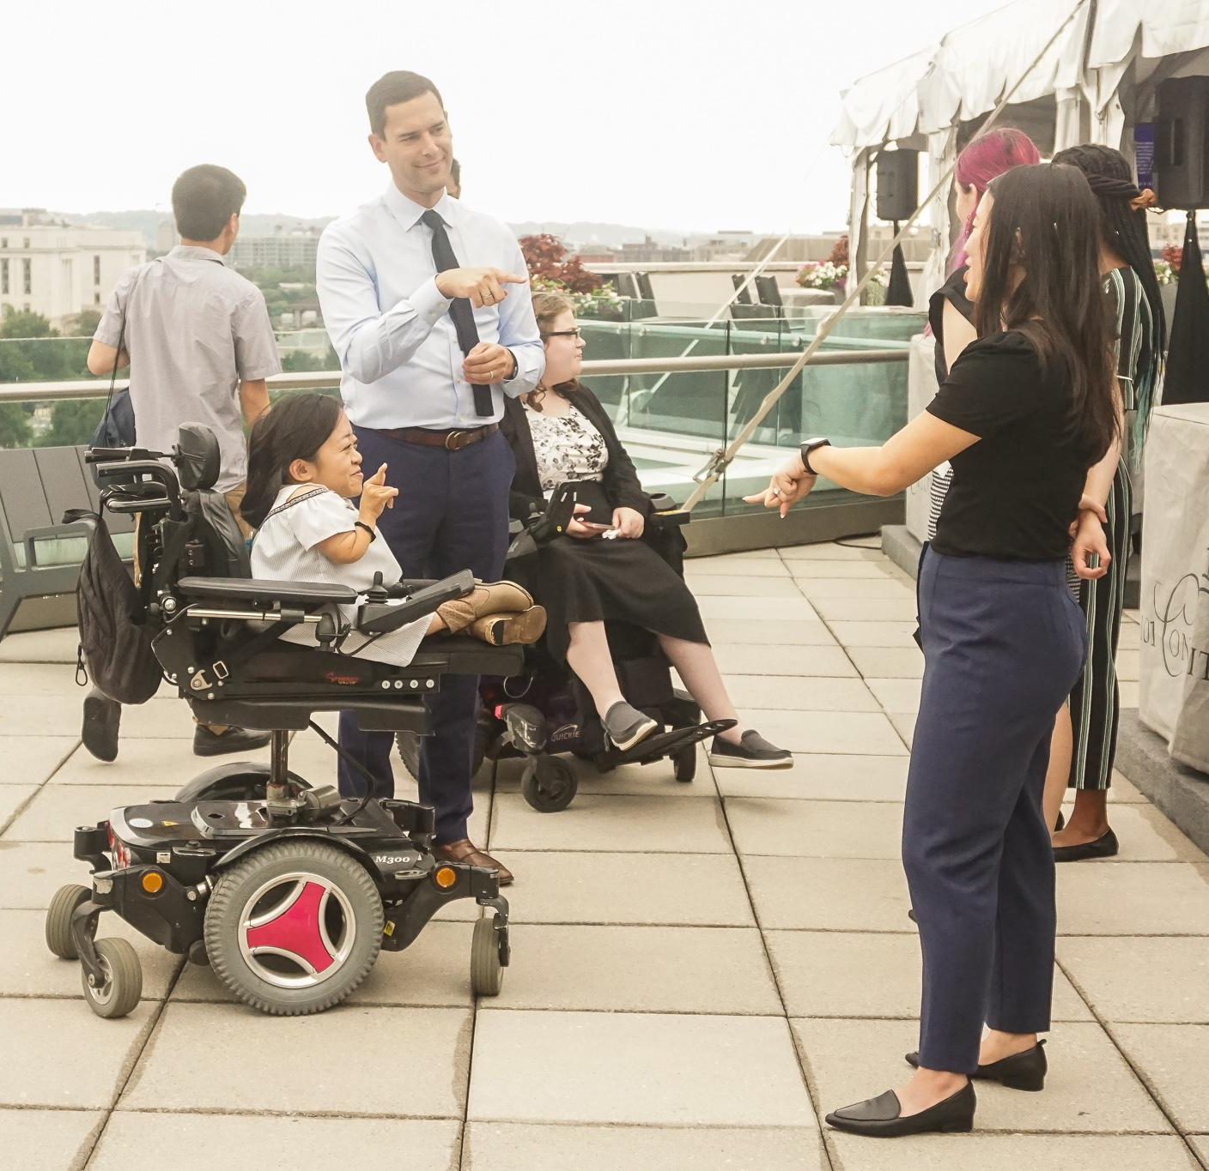
Mentorship & Community
1:1 virtual mentorship from community leaders
Community events & networking opportunities

Slide 8
Important Dates
Program Dates: October 2 to December 8, 2023
Virtual Orientation: Saturday, September 29 from 12:00-5:00pm ET
In-Person Gathering: November 3-6, 2023
AAPD pays travel and hotel costs.

Slide 9
Internship Application Components
General Information
Resume
Internship Placement
3 Essay Questions
References
Demographics (optional)

Slide 10
Sections 1 & 2
General Information
Contact Info
Eligibility
AAPD-related questions
Resume
Represent your whole self

Slide 11
Sections 3 & 4
Placement Preferences
Choose top three
Provide additional placement-specific materials
3 Essay Questions
Helps us understand you as a leader
Share details & specifics
Answer the questions fully

Slide 12
Sections 5 & 6
References
At least 1 professional
1 can be personal
Demographics (optional)
Disability
Sexual Orientation
Gender & Pronouns
Veteran Status
Race
Age
Religion

Slide 13
Application Timeline
Application Due: Thursday June 8 at 11:59pm ET
Application Review: Early June
Interviews: June-August
Decisions: End of August 2023

Slide 14
Questions?
Type your questions in the Q&A box.
Raise your hand to speak.
Email Katie at internships@aapd.com

