Slide 1
2024 Paul G. Hearne Emerging Leader Award Webinar
Monday, October 16, 2023
4:00pm – 5:00pm ET

Slide 2
Housekeeping Items
Recording available in 3-5 business days
Includes PowerPoint slides
Closed captioning and StreamText
ASL Interpreters pinned
Questions and answers at the end of the webinar
If you have questions, please put them in Q&A box only
Chatbox is only for interactive component and will not be read

Slide 3
Agenda
AAPD and Paul G. Hearne
Timeline
Application Process
Past and current Hearne Awardees
Questions and Answers

Slide 4
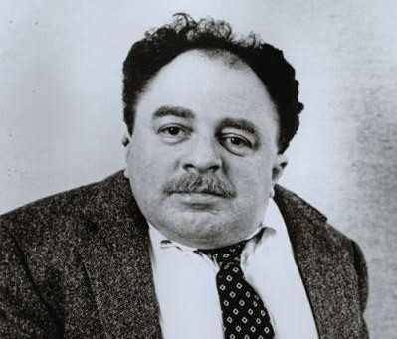
Paul G. Hearne
Award named after a lifelong disability advocate and leader
One of AAPD’s co-founders
One Break and The Dole Foundation for Employment of People with Disabilities
Two passions:
Create a national association of people with disabilities
Cultivate potential leaders to carry on the disability rights movement

Slide 5
Timeline

Slide 6
Timeline
Deadline: Wed, October 25, 2023 at 5pm ET
Review and interviews: November 2023 to January 2024
Final notification: January 2024
Project timeline: January 2024 – December 2024
AAPD’s Virtual Gala: Spring 2024

Slide 7
Application Process

Slide 8
Application Sections
Applicant Information
Resume
Project Information
Letters of Support
Optional demographics
Not all suggestions/tips may apply!

Slide 9
Section 1: Applicant Information
You are eligible if you self-identify as:
Emerging Leader
Person with a disability
Emerging leader is not tied to:
Age, education status, employment, specific experience or involvement with disability community
Do not need to disclose your disability
Groups up to 4 people can apply
Everyone still must identify as an emerging leader with a disability

Slide 10
Section 1: Applicant Information
Name
Phone number
Email
If applicable: Group Member names

Slide 11
Section 2: Resume
List activities and experiences that directly relate to your project
Can include all kinds of experiences:
Volunteer
Internship / fellowships
Temporary, part-time, full-time
If applicable: Group members’ resumes

Slide 12
Section 3: Project Information
Relate your project to AAPD’s mission
Provide enough background to make sure all reviewers have the same understanding of your project
Share specifics if you have them
Word counts for each essay question
If there is a higher word count, it means reviewers will pay closer attention

Slide 13
Section 3: Project Information
Recipients will receive $7,500 for the project
Recipients will receive $2,500 for their contribution to the disability community

Slide 14
Section 3: Project Information
AAPD disburses the funds to wherever the recipient chooses. Two main options include:
501(c)3 entity, can be either self or fiscal intermediary
AAPD cannot serve as a fiscal intermediary
Directly to the recipient
If directly, it will be counted as taxable income
Consider taxes as part of the budget planning process

Slide 15
Section 4: Letters of Support
Two letters required
People who can speak to your leadership style and your project
Conflict of interest: Board members, AAPD staff, or a relative of any of these individuals, or if applicable, group members

Slide 16
Section 5: Demographics (Optional)
Helps AAPD get a better sense of our outreach efforts to diverse communities
Demographic questions include, but not limited to:
Race
Gender
Religion
Sexual orientation
Disability

Slide 17
Tips and Encouragement
Look at AAPD’s mission and how the project relates
Preview the Word document
Ask questions!
Email, set up calls
Welcome new ideas!
Know that AAPD is here to support

Slide 18
Hearne Awardees
Sneha Dave (2020) and Elijah Armstrong (2021)

Slide 19
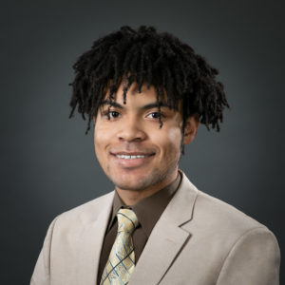
Past Hearne Awardees
Sneha Dave
Elijah Armstrong
2020 Awardee
Generation Patient
2021 Awardee
Heumann-Armstrong Award

Slide 20
Questions?
Email Christine at programs@aapd.com with any questions

