Slide 1
2024 AAPD Summer Internship Program
Information Session
October 3, 2023 4pm-5pm EST

Slide 2
Housekeeping Items
Recording available next week
Closed Captioning
ASL Interpreters
Questions & Answers

Slide 3
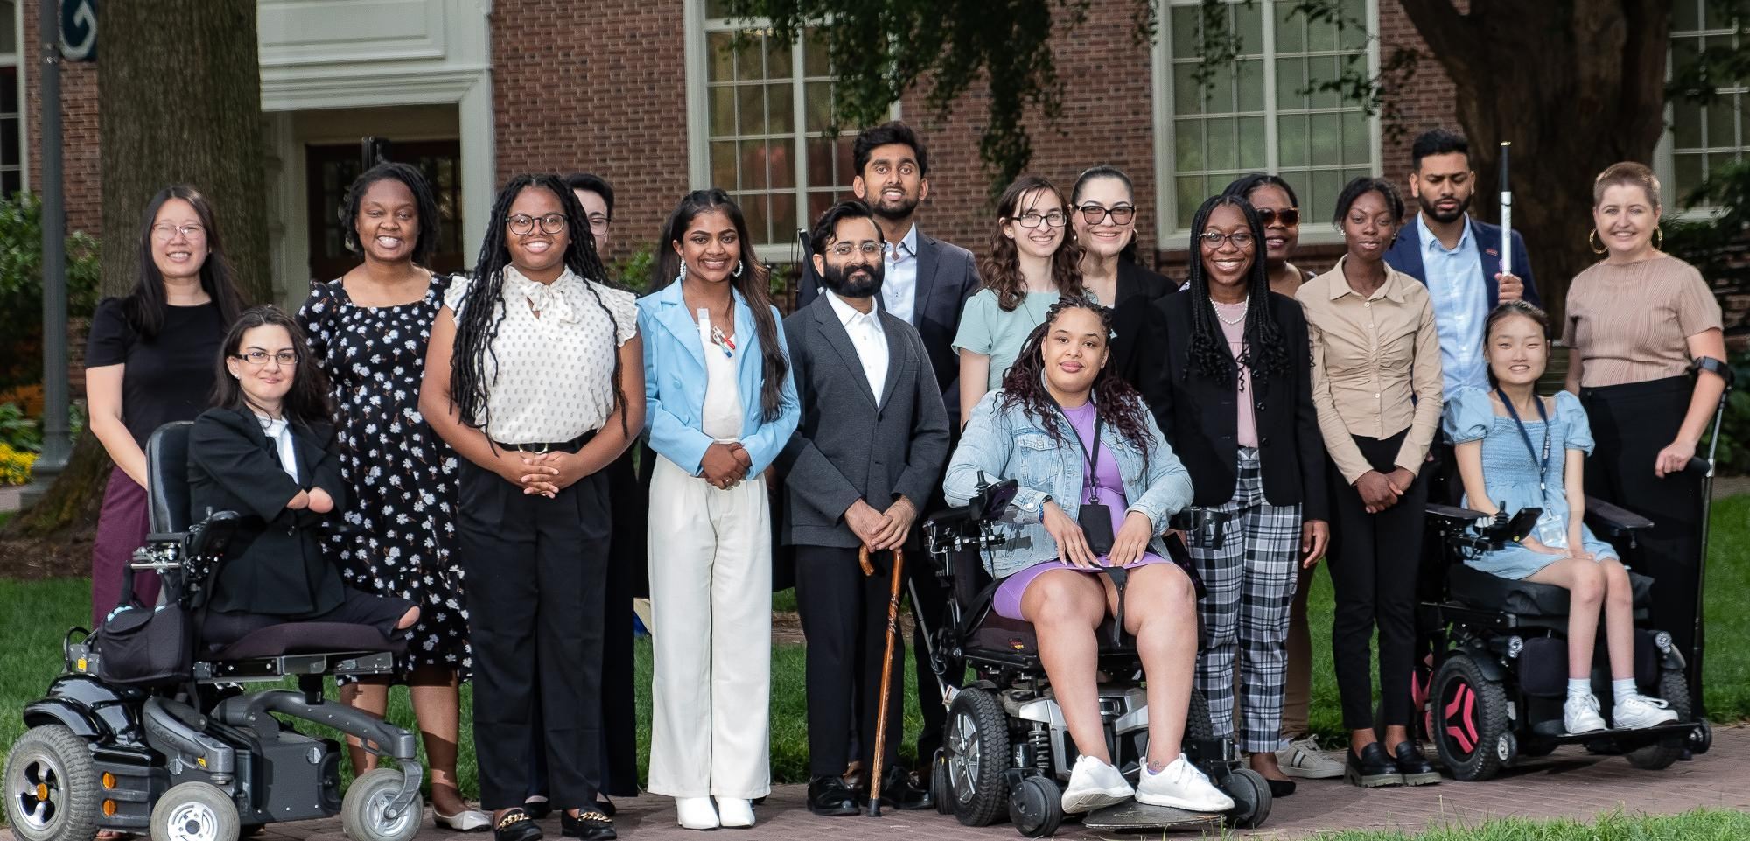
Agenda
Overview of Summer Internship Program
Application Process and Timeline
Alumni Panel
Q&A and Wrap Up

Slide 4
The 2024 Summer Internship Program
Hybrid Program
10 week paid full-time internship
Work 32 hours a week, Monday-Thursday
Assortment of internship placements

Slide 5
Disability Advocacy Certificate Program
Advocacy using storytelling
Weekly speakers or class discussions
2023 Assignments: Policy Memo, Meeting with an Elected Official, Advocacy Plans Presentations

Slide 6
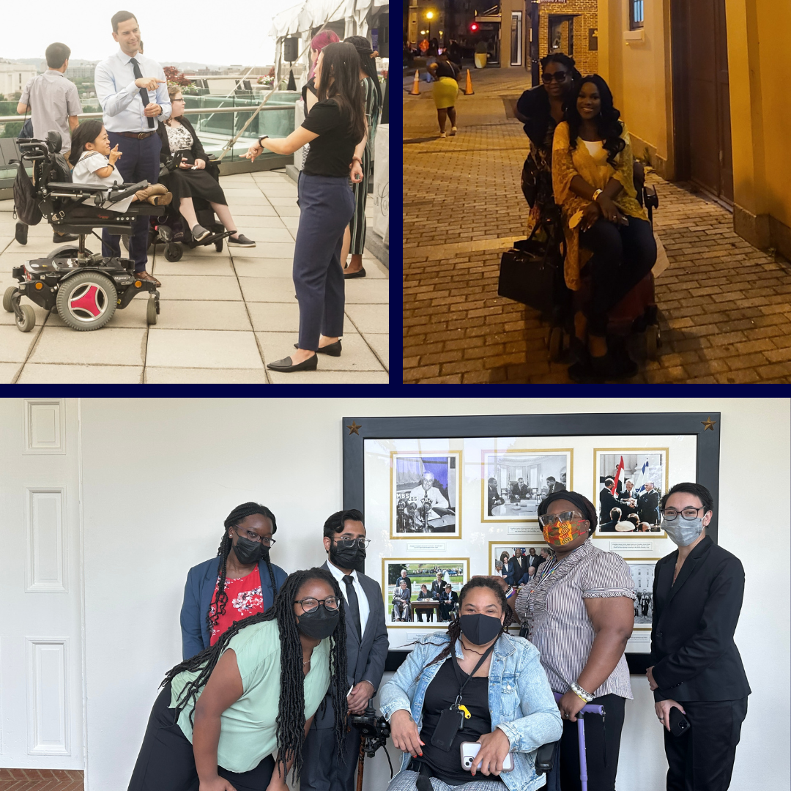
Mentorship & Community
1:1 mentorship from community leaders
Community events & networking opportunities

Slide 7
Internship Application Components
General Information
Resume and References
Internship Placement
3 Essay Questions
Demographics (optional)

Slide 8
Sections 1 & 2
General Information
Contact Info
Eligibility
AAPD-related questions
Resume
References
At least 1 professional
1 can be personal

Slide 9
Sections 3 & 4
Internship Preferences
Congressional, Federal, Non-profit, For-Profit
In-person, remote, or flexible
3 Essay Questions
Helps us understand you as a leader
Share details & specifics
Answer the questions fully

Slide 10
Section 5
Demographics (optional)
Disability
Sexual Orientation
Gender
Veteran Status
Race
Age
Religion

Slide 11
Application Timeline
Application Due: October 19th at 5pm ET
Application Review: Early November
Interviews: November - January
Decisions: End of January 2024

Slide 12
Internship Alumni Panel
Jessica Lopez
2023 Remote Intern
Office of Disability Employment Policy
Christina Stafford
2023 In-Person Intern
Center for American Progress
Zandy Wong
2022 In-Person Intern
Office of Rep. Katie Porter

Slide 13
Questions?
Type your questions in the Q&A box.
Raise your hand to speak if you’d like to be unmuted.
Email Katie at internships@aapd.com

